Slide 1

The 2025 Survey

Slide 2
Scope
Why survey?
Statistics
Analysis
Results
Where to from here?

Slide 3
Why survey?
Branch chairs suggestion
“What do our members think?”
Board agreed, to improve business planning

Slide 4
Statistics
44 questions: 39 national, 5 from branches
21 multiple choice, 23 free text
1730 responses – 21% of members, 102 ACT

Slide 5
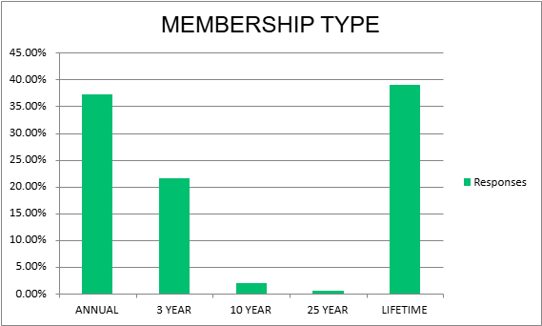

Slide 6
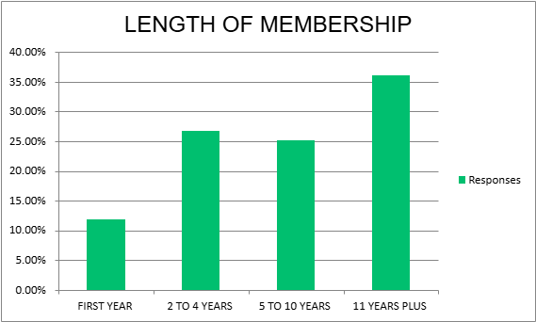

Slide 7
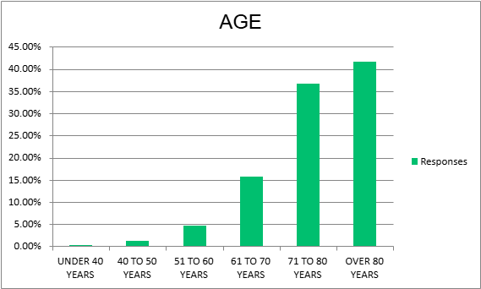

Slide 8
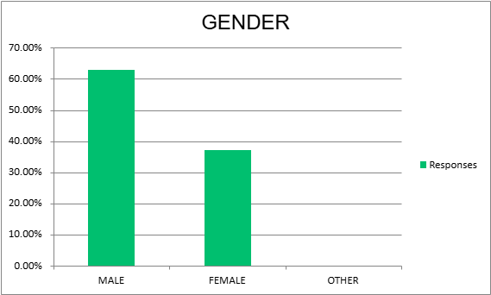

Slide 9
Analysis
Each National question assigned an “owner”
Branches analysed branch questions
Example: Question 3

Slide 10
Q3: Why did you join the Association?
Owner: Director ACT
Number of Responses: 1682
Task: Identify five themes and three recommended actions

Slide 11
Introducing Artificial Intelligence …
… a set of technologies that enables computers to simulate human learning, comprehension, problem solving, and decision-making … (IBM)
Enter Claude!

Slide 12
“The data to be analysed comes from a survey of members of a community-based association… The question I want to analyse is “why did you join the association”… Please exclude all unclear responses but note how many there were. I want to know the top five themes … and the top three recommendations for action arising. I want you to present the analysis as a report for the association board.”

Slide 13
Question 3 Themes (why people join)
Fellowship and to connect with like-minded people (35%)
To support the Association and the Order of Australia (21%)
It seemed a natural progression following award (19%)
To get information and stay informed (13%)
To continue community service and give back (10%)

Slide 14
Question 3 Recommended Actions
Strengthen fellowship programs
Enhance member communication and engagement
Develop structured community service pathways

Slide 15
Analysis
Each National question assigned an “owner”
Branches analysed branch questions
Example: Question 3
Aggregation and prioritisation

Slide 16
Results
Claude identified four themes:
  Promote citizenship
  Transform communications
  Improve organisational effectiveness
  Strengthen the membership base

Slide 17
Results
Claude identified four themes:
  Promote citizenship
  Transform communications
  Improve organisational effectiveness
  Strengthen the membership base
Strategic plan objectives:
  Grow value of membership
  Promote nominations
  Build member numbers
  Invest in community

Slide 18
Results
Claude identified 60 actions!
Board (wisely) decided to prioritise!!
Asked Claude for top 5 plus another 5
Strategy Committee analysed, refined

Slide 19
Top 5
Modify The Order to emphasise citizenship
Introduce a ‘share it out’ program for The Order
Update all advertising to emphasise citizenship
Add a QR code linked to The Order to all publications
Include Foundation scholarship winners in event

Slide 20
Next priorities
Introduce hybrid model for 2027 Conference
Partner in a podcast program
Promote & extend schools programs
Form a communications team to align all comms

Slide 21
Where to from here?
Communication with members
Strategy Committee developing implementation plan
Reflect and learn lessons from the survey

Slide 22

Questions?
Current November 2022

