Slide 1



How to nominate
How to nominate outstanding
achievement and service for an
Order of Australia Honour

Slide 2
Who are we?
Our Association
The Order of Australia Association Ltd is an incorporated body of recipients of awards or appointments in the Order of Australia. The Association needs to be robust, flexible and responsive to the members’ needs and to serve as a model for community engagement.
The object of the Association is to pursue the following charitable purpose: To celebrate and promote outstanding Australian citizenship.
To be recognised as an Australian leader in fostering community awareness of our history, traditions and culture, and in promoting good citizenship.
Our Purpose
Our Vision

Slide 3
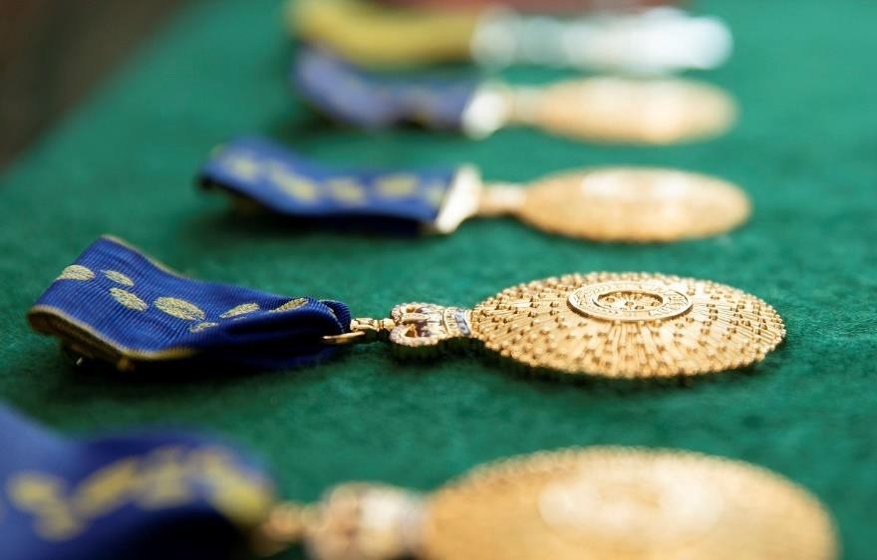
What is the Order of Australia?
Principal means of recognising outstanding members of the community.
Nominations are encouraged from all members of the Australian public.
Anyone can nominate a member of the community for recognition.
The Order of Australia was established in 1975 by Her Majesty Queen Elizabeth II

Slide 4

Order of Australia: Philosophy
The Order of Australia is how to honour, celebrate and recognise the people in our community who have an impact at the local, national and international level
The Order of Australia serves to Define, Encourage and Reinforce
  community standards
  national aspirations and ideals; by,
  acknowledging actions and achievements
  identifying role models
Encourage nominations from all fields of endeavour.

Slide 5

Order of Australia: Promotional Material
Promotional materials, including profiles of recipients and guidance products are available at www.gg.gov.au (search guidance and promotion)
Click on Tab: Order of Australia Guidance and Resources for resources to assist:
1. an electronic toolkit including social media assets, editorial and videos
2. a printable factsheet
3. guidance about the process, including answers to commonly asked questions
Encourage nominations from all fields of endeavour.

Slide 6
Order of Australia: who is celebrated
No-one, no matter who they are or what they have done can be recognised unless they are nominated
Honours lists reflect the nominations that are submitted
You can nominate any one at any time to have your say in who is celebrated, and the types of service and achievements that matter
Encourage nominations from all fields of endeavour.

Slide 7

Order of Australia: Structure
Companion (AC) Officer (AO) Member (AM)
Medal (OAM) Two divisions: General & Military

Slide 8

Order of Australia: Structure
King Charles III is Sovereign
Governor-General is Chancellor
Official Secretary serves as Secretary of The Order of Australia
Independent and is free from political patronage.

Slide 9

Order of Australia: Council
Independent
19 including representatives of each state and territory
Community representatives appointed by Governor-General on recommendation of Prime Minister
Meets twice per year usually February and August
Considers each nomination
Makes recommendations to Governor-General
The Council operates under and by the Constitution of the Order of Australia

Slide 10
How to nominate
Anyone can nominate a member of the community for an award
Thousands of nominations are processed each year. Given the volume, from 1 July 2027, the time from nomination to outcome will be 12-18 months.
Some nominations may take longer should the Council for the Order of Australia elect to defer making a decision to seek additional information
On-line nomination available at https://www.gg.gov.au

Slide 11
How to nominate
Nominations are confidential
Nominator and referees (3) details required
Details of how the nominee has made a significant contribution
Process managed by the Honours Secretariat at Government House Canberra
Unsuccessful nominations may be reconsidered again after 3 years

Slide 12

Tips
Gather as much information as you can about the person you are nominating
You will need to list three referees including their email address, so consider this before you start the nomination
Make a short case of why/who you are nominating; including
examples of the impact they have made
what they have done to make things better for others
the role(s) or area(s) in which they have excelled
the period of time, or dates of service (if known)
evidence of other awards or recognition received by the nominee

Slide 13


Do you know someone who deserves recognition?
Consider inclusivity and diversity of age, gender, culture and all sectors of society when nominating worthy achievers.
Please nominate them now!
Current August 2026

